Slide 1
INTRODUCTION
QUANTITATIVE FINANCE IN PYTHON

Slide 2
About me:
From Budapest, Hungary
BSc in physics
MSc in applied mathematics
Working as a software engineer
Special addiction to algorithms + AI + models concerning quantitative finance such as the Black-Scholes model or credit risk, Merton-model

Slide 3
About the course:
Stock market basics: stocks, options and other derivatives
Modern Portfolio Theory (Markowitz-model)
Capital Asset Pricing Model (CAPM)
Stochastic calculus
Black-Scholes model – option pricing
Value at Risk (VaR)
Machine learning techniques in finance

Slide 4
HD option for videos

Slide 5
Why Python?
1.) Python is very easy to learn compared to other programming
languages such as C or C++
2.) Libraries: several available libraries (machine learning, statistics
and numerical methods)
Significantly reduces time to implementation
NumPy – vectorized operations
Pandas – time series analysis
SciPy – optimization algorithms / numerical methods
3.) Quite fast: OK not as fast as C++ (so for HFT C or C++ is used)
Python provides scientific computing components
that are heavily optimised via vectorisation
4.) Trade execution: several plugins exist for larger brokers
For example: Interactive Brokers

Slide 6
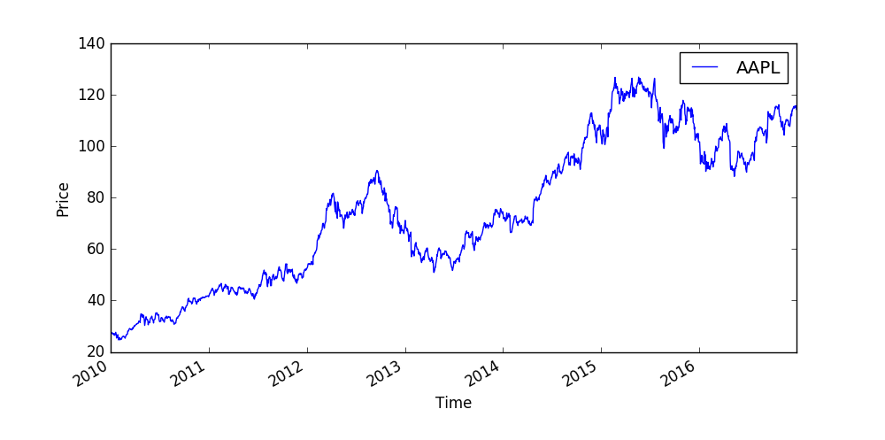
Financial models

Slide 7
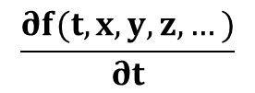
Financial models
What are the problems concerning financial models?
Most of the models rely heavily on historical data
~ so we assume that the conditions are not going to change
// Markowitz-model, CAPM ...
We calculate the parameters of these models based on data
in the past !!!
DYNAMIC MODELS MAY BE BETTER !!!
So maybe we should define how the parameters
evolve in the course of time
$$\frac{∂f(t,x,y,z,…)}{∂t}$$
= 0

Slide 8
Stock market basics
STOCKS
Stocks or shares are the ownership of a small
piece of a company !!!
if you have a good idea: you can raise capital by selling
off future profits in the form of shares
This is how most of the startups begin !!!
the investor or shareholder gives you cash
In return he gets a contract stating how much
of the company he owns ~ and this is exactly what stocks are
THIS IS HOW SMALL COMPANIES BEGIN !!!

Slide 9
Stock market basics
STOCKS
Why is it good to buy stocks?
→ dividends + any growth in the stock’s value
Dividends are payments paid out every quarter or every
six months to the shareholder
→ the amount of dividend depends on the profitability of
the given company

Slide 10
Stock market basics
STOCKS
Investing in stocks is quite risky: it depends on
the volatility

Slide 11
Stock market basics
STOCKS
What is volatility?
→ statistical measure of the dispersion of returns
for a given security
~ amount of uncertainty/risk about the size of changes
in the value of a given security (stock, bond etc.)
→ we can measure volatility with standard deviation
or variance between returns of the same
security
HIGHER THE VOLATILITY, THE RISKIER THE SECURITY !!!
How to approximate volatility? With CAPM beta value

Slide 12
Stock market basics
COMMODITIES
Commodities are raw products: gold, silver, oil ...
→ the price of these products are unpredictable BUT
often show seasonal effects
→ scarcity of the product results in higher prices
and vica-versa
→ most trading is done on the future market
You can make deals to buy/sell a given
commodity at some time in the future !!!

Slide 13
Stock market basics
CURRENCIES
Another financial equity is the exchange rate: so the rate at which a
given currency can be exchanged for another
FOREX = Foreign Exchange
→ the top currencies to consider: USD, CAD, AUD, YEN and EUR
→ there may be some mispricings: you can make arbitrage profits
by exploiting these mispricings
For example: with Bellman-Ford algorithm
→ fluctuation in exchange rates is unpredictable BUT
it has something to do with interest rates

Slide 14
Stock market basics
CURRENCIES
Here is a table of exchange rates
It contains the relative values
~ are there any arbitrage opportunities?
 | USD | EUR | GBP | CHF | CAD
USD | 1 | 0.741 | 0.657 | 1.061 | 1.011
EUR | 1.35 | 1 | 0.889 | 1.433 | 1.366
GBP | 1.521 | 1.126 | 1 | 1.614 | 1.538
CHF | 0.943 | 0.698 | 0.62 | 1 | 0.953
CAD | 0.955 | 0.732 | 0.65 | 1.049 | 1

Slide 15
Stock market basics
CURRENCIES
We can construct a directed graph G(V,E) out of
the exchange rate table
→ the nodes of the graph are the currencies
→ the edges are the relative values
We take the natural logarithm of the edges
+ mutiply the edges by -1 !!!
We end up with a negative edge weighted graph
where the negative cycles are the arbitrage
opportunities !!!
USD
GBP
EUR
CHF
CAD
How to detect these negative cycles? Bellman-Ford shortest path
algorithm with O(V*E) running time complexity

Slide 16
Stock market basics
BONDS
A bond is a debt investment in which an investor loans money to
an entity (company or government)
→ for a defined period of time
→ variable or fixed interest rate
BONDS ARE FIXED-INCOME SECURITIES !!!
So when a company needs to raise money to finance new projects they
may issue bonds directly to investors instead of obtaining
loans form bank !!!
~ interest rate of bonds are usually a bit higher
than that of the banks

Slide 17
Stock market basics
BONDS
Credit rating agecies: Moody’s Investors Service, Standard & Poor’s
~ these agencies assign ratings to bond issuers: if the issuer
has poor credit rating → risk of default is greater
longer the bond maturity (so long term bonds), greater
the probability of default
so bonds with longer time to maturity typically have
higher interest rates !!!
BONDS IN THE MAIN ARE NOT THAT RISKY !!!

Slide 18
Stock market basics
BONDS
Credit rating agecies: Moody’s Investors Service, Standard & Poor’s
~ these agencies assign ratings to bond issuers: if the issuer
has poor credit rating → risk of default is greater
longer the bond maturity (so long term bonds), greater
the probability of default
so bonds with longer time to maturity typically have
higher interest rates !!!
BONDS IN THE MAIN ARE NOT THAT RISKY !!!

Slide 19
Stock market basics
BONDS PRICING
par value - $1000
10% rate/coupon
2 years
So investors can buy a given bond from a company (or government)
What does it mean? In 2 years the buyer will receive $1000
plus 10% premium
How much would an investor pay for a bond?
We have to calculate the present value of that
future cash flow (because we get $1000
in the future!!!)

Slide 20
Stock market basics
BONDS PRICE AND INTEREST RATE
par value - $1000
10% rate/coupon
2 years
Interest rates and bond prices are negatively correlated
→ if interest rates rise: bonds prices decline
→ interest rates fall: bonds prices rise
Of course who wants a 10% yield when they can get 15% instead?

Slide 21
Stock market basics
BONDS PRICE AND MATURITY
bond A expires in 1 year
bond B expires in 10 years
Of course there is some risk involved when dealing with bonds as well
Longer loans are riskier: the company may default, there is
more uncertainty
What does it mean?
Interest rate (coupon) for bond B will be greater
than for bond A ... investors bear more risk
for greater return !!!

Slide 22
Stock market basics
BOND-PRICING: there are two types of bonds – coupon bonds and
zero-coupon bonds
1.) zero-coupon bonds
$1000
0 1 2
T=3 years
We just have to colculate the present value
of a future cash flow because we get
$1000 in 3 years time !!!
x
$1000
BP =
=
= $889
n
3
(1+r)
(1+0.04)

Slide 23
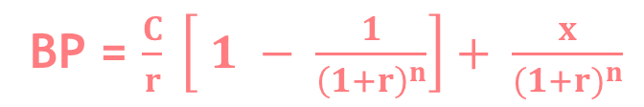
Stock market basics
BOND-PRICING: there are two types of bonds – coupon bonds and
zero-coupon bonds
2.) coupon bonds
$50
$50
$50 + $1000
0 1 2
T=3 years
There is an annual coupon rate: here it is 5%
+ the investor gets the par value at expiry
in this case in 3 years time
BP = present value of annuity + present value of par value
BP = $\frac{C}{r} \left[ 1 − \frac{1}{{\left(1+r\right)}^{n}}\right]+ \frac{x}{{(1+r)}^{n}}$
c: annual coupon payment
r: interest rate

Slide 24
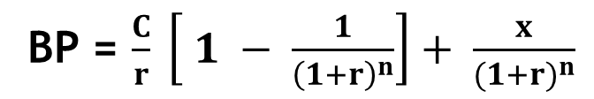
Stock market basics
BOND-PRICING: there are two types of bonds – coupon bonds and
zero-coupon bonds
2.) coupon bonds
$50
$50
$50 + $1000
0 1 2
T=3 years
BP = $\frac{C}{r} \left[ 1 − \frac{1}{{\left(1+r\right)}^{n}}\right]+ \frac{x}{{(1+r)}^{n}}$
bond yield: 5%
market interest rate: 4%
BP = $\frac{50}{0.04} \left[ 1 − \frac{1}{{\left(1+0.04\right)}^{3}}\right]+ \frac{1000}{{(1+0.04)}^{3}}=\$1027.75$

Slide 25
Stock market basics: positions
LONG POSITION ← → SHORT POSITION
Long position: long position in a security means that you own
the security.
Investors meaintain long positions in the
expectation that the stock will rise in value in the future !!!
Short position: short position is generally the sale of a given stock
Investors who maintain short position believe the price of
stock will decrease in value !!!

Slide 26
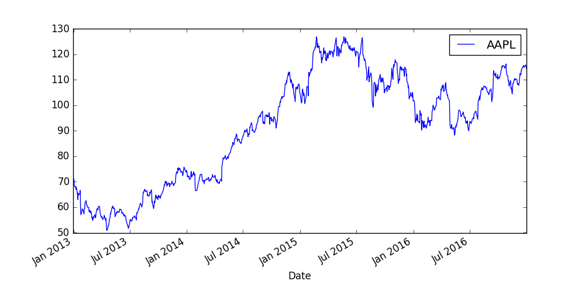
Stock market basics: positions
LONG POSITION ← → SHORT POSITION

Slide 27
Time value of money
The most important concept in finance is that of the time value of
money $x today is worth more than $x in a year’s time !!!
Why? because we may invest $x today
→ we may invest it into stocks
→ we can lend it to bank for some interest
Future money worth less because inflation will push prices higher
so the buying power of your money will be lower !!!

Slide 28
Time value of money
The most important concept in finance is that of the time value of
money $x today is worth more than $x in a year’s time !!!
Why? because we may invest $x today
→ we may invest it into stocks
→ we can lend it to bank for some interest
n
x (1+r)
this is the future value of $x: we may get
premium because of the interest rate
r: interest rate (0.05 for 5%)
n: number of years
Future value (FV) is the value of a current asset at a specified
date in the future based on an assumed rate of growth over time

Slide 29
Time value of money
The most important concept in finance is that of the time value of
money $x today is worth more than $x in a year’s time !!!
Why? because we may invest $x today
→ we may invest it into stocks
→ we can lend it to bank for some interest
x
this is the present value of $x: we have to
take interest rate into consideration
n
(1+r)
r: interest rate (0.05 for 5%)
x: cash flow in the future
n: number of years
Present value (PV) defines how much a future sum of money is
worth today given a specified rate of interest

Slide 30


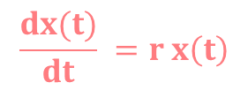
Time value of money
So far we have discussed the discrete model
~ we may construct a continuous model with differential equations
Suppose we have amount x(t) in the bank in time t. How much does this
increase in value from one day to the next?
x(t+dt) – x(t) = $\frac{dx(t)}{dt} dt$
the change in the amount of
money within a dt day
Taylor-expansion or the
definition of derivatives
But the interest I receive must be proportional to the actual x(t) amount I have
and the r interest rate and the dt time step !!!
x(t+dt) – x(t) = $\frac{dx(t)}{dt} dt$
= r x(t) dt
$$\frac{dx(t)}{dt} =r x\left(t\right)$$
r*t
the solution is x(t) = x(0) e

Slide 31
Modern Portfolio Theory
It was formulated in the 1950s by Harry Markowitz
~ the Nobel Prize in Economics was awarded to the inventor !!!
What is the main idea?
A single stock is quite unpredictable: we do not know for certain
whether the price will go up or down
BUT we may combine several stocks in order to
reduce the risk as much as possible !!!
„DIVERSIFICATION”
Combining assets is the main idea: it is the same for
Black-Scholes model !!!

Slide 32
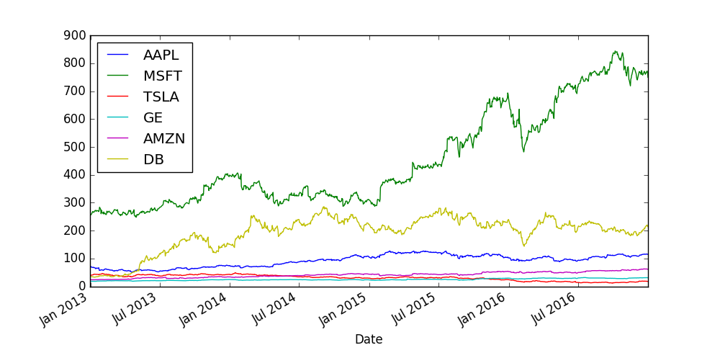
Modern Portfolio Theory

Slide 33
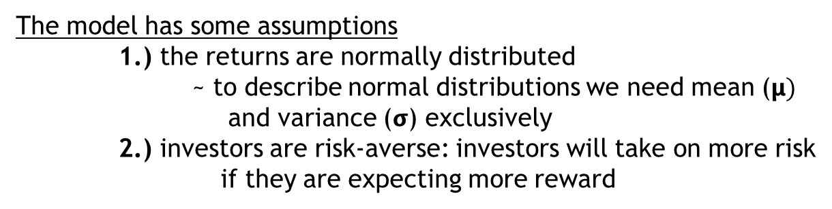
Modern Portfolio Theory
The model has some assumptions
1.) the returns are normally distributed
~ to describe normal distributions we need mean ($μ)$
and variance ($σ$) exclusively
2.) investors are risk-averse: investors will take on more risk
if they are expecting more reward
Low risk → lower return
Higher return → higher risk as well
With modern portfolio theory, investors can construct optimal portfolios
offering the maximum possible expected return for
a given level of risk !!!
So what is an „efficient portfolio”? That has the highest reward for
a given level of risk OR the lowest risk for a given reward !!!

Slide 34
Modern Portfolio Theory
The investors are not allowed to set up short positions in a security
So 100% of the wealth has to be divided among available assets (stocks)
in a way that all positions are long
For example: AAPL, GOOGL, TSLA, GE
AAPL GOOGL TSLA GE
20% 30% 25% 25%
0.2 0.3 0.25 0.25
weights = [0.2, 0.3, 0.25, 0.25]
Of course the sum of weights is 1 because 100%
of the investor’s wealth is divided among the available assets !!!

Slide 35

Modern Portfolio Theory
w
weight of the i-th asset/stock
i
r
return of the i-th stock // calculated on historical data
i
$$μ$$
expected return for security i // it is mean basically
i
How to calculate return? We can calculate the return on a day-by-day basis
stockPrice - stockPrice
n
n-1
x 100 [%]
stockPrice
n-1

Slide 36
Modern Portfolio Theory
Usually we use the natural logarithm as the return !!!
stockPrice - stockPrice
n
n-1
stockPrice
n-1
we use the logarithm of returns instead of actual prices of stocks
Form of a normalization: important for machine learning techniques
and statistical analysis
stockPrice
n
log ( )
stockPrice
n-1

Slide 37



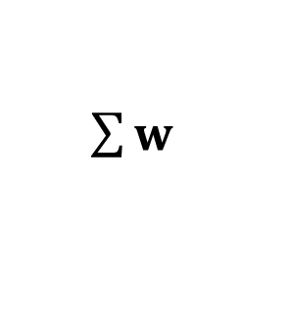
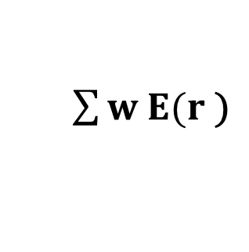

Modern Portfolio Theory
w
weight of the i-th asset/stock
i
r
return of the i-th stock // calculated on historical data
i
$$μ$$
expected return for security i // it is mean basically
i
This model relies heavily on historical data
Historical mean performance is assumed to be the best estimator
for future (expected) performance
w
T
$$μ =$$
E ( $\sum{w r\text{ )}}$
$\sum{w E(r \text{)}}$
$\sum{w }$
$$μ$$
=
$$μ$$
=
=
portfolio
i
i
i
i
i
i
i
i
i
EXPECTED RETURN OF THE PORTFOLIO !!!

Slide 38
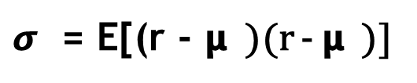
Modern Portfolio Theory
What about the risk of the portfolio?
The risk has something to do with volatility !!!
Volatility has something to do with standard deviation
and variance !!!
$σ$ = E[(r - 𝝻 )(r - 𝝻 )]
„covariance”
ij
i j
j i
Covariance measures how much two random variables vary together
𝞂 < 0 negative covariance means returns move inversely
𝞂 > 0 positive covariance means that asset returns move together
ij
ij
Markowitz’s theory is about diversification: possessing assets (stocks) with
high positive covariance does not provide very
much diversifiaction !!!
~ the aim of diversification is to eliminate fluctuations
in the long term ... so uncorrelated stocks are better !!!

Slide 39
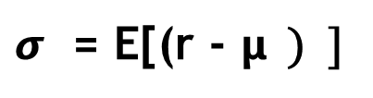
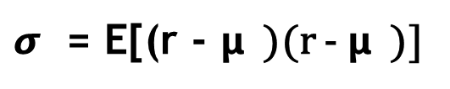
Modern Portfolio Theory
What about the risk of the portfolio?
The risk has something to do with volatility !!!
Volatility has something to do with standard deviation
and variance !!!
$σ$ = E[(r - 𝝻 )(r - 𝝻 )]
„covariance”
ij
i j
i j
2
2
$σ$ = E[(r - 𝝻 ) ]
„variance”
i
i
i
For calculating the variance of the portfolio we need the
covariance matrix containing all the covariances
of the stocks involved in the portfolio !!!

Slide 40







Modern Portfolio Theory
2
...
$$σ$$
$$σ$$
$$σ$$
1
12
1n
.
.
.
.
.
.
𝝨
=
...
2
$$σ$$
$$σ$$
n1
n
This covariance matrix contains the relationship between all
the stocks in the portfolio
2
2
$$\sum{\sum{w w σ }}$$
T
$$σ =$$
E[(r - 𝝻 ) ]
= w 𝝨 w
=
j
ij
portfolio
i i
i
i
j
EXPECTED PORTFOLIO VARIANCE !!!

Slide 41
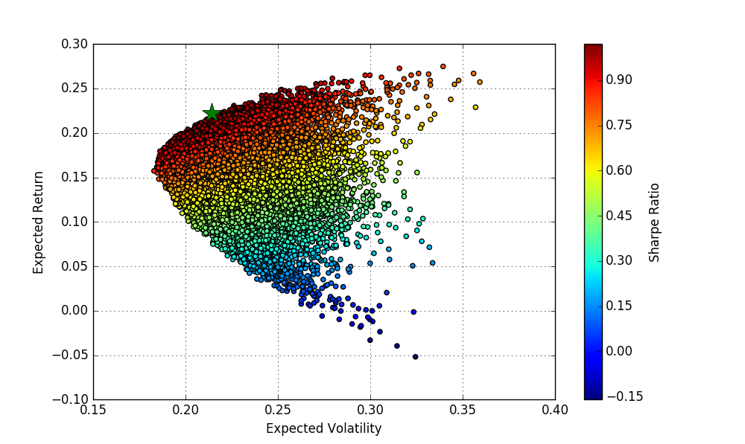
Modern Portfolio Theory
The dots represent different w
weights → so different portfolios
An investor is interested in
1.) the maximum return given a fixed
risk level
2.) minimum risk given a fixed return
These portfolios make up the so-called „efficient-frontier” !!!
This is the main feature of Markowitz model: the investor can decide
the risk or the expected return
→ basic rule: if you want to make money, you have to take risk !!!

Slide 42
Modern Portfolio Theory
A
B
RETURN
C
D
RISK

Slide 43
Modern Portfolio Theory
RETURN
RISK

Slide 44
Modern Portfolio Theory
RETURN
RISK

Slide 45
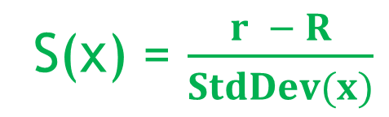
Modern Portfolio Theory
What is Sharpe-ratio?
It is one of the most important risk/return measures used in finance
William Sharpe used this parameter !!!
it describes how much excess return you are receiving
for extra volatility that you endure holding a riskier asset (stock)
S(x) = $\frac{r − R}{StdDev(x)}$
x
f
r
average rate of return of investment x
x
R
rate of return of risk-free security
f
A Sharpe-ratio S(x) > 1 is considered to be good

Slide 46
Modern Portfolio Theory
What is Capital Allocation Line?
Investors can have risk-free assets
as well usually: for example
treasury bills !!!
Considering this fact what is the
optimal portfolio now?
The optimal portfolios lie on the
capital allocation line !!!
this is the capital
allocation line
RETURN
portfolio with maximum
Sharpe-ratio
risk-free
asset
RISK

Slide 47
Monte-Carlo Simulations
Monte-Carlo method solves a deterministic problem using
probabilistic analog
1.) define a domain of possible inputs
2.) generate inputs randomly
3.) perform a deterministic computation on
the inputs
4.) aggregate the results
We can calculate the area of a circle with Monte-Carlo
approach
Just have to generate random points in the plane
within [0,a]
~ then calculate the points inside and
outside of the circle: the ratio
can yield the area !!!
a
a

Slide 48
Capital Asset Pricing Model (CAPM)
Markowitz-model is working quite fine
BUT we can not get rid of all risk by diversification !!!
There are two types of risk:
1.) Unsystematic risk: „specific risk”
This is the risk specific to individual stocks
~ it can be diversified away by increasing the number
of stocks in the portfolio !!!
UNSYSTEMATIC RISK IS THE COMPONENT OF A STOCK’S RETURN
THAT IS NOT CORRELATED WITH MARKET MOVES
2.) Systematic risk: „market risk”
This risk can not be diversified away
For example: interest rates, recession or war
CAPITAL ASSET PRICING MODEL MEASURES THIS RISK

Slide 49

Capital Asset Pricing Model (CAPM)
It was formulated in the early 1960s by William F. Sharpe and
his colleagues
E[r ] = r + β ( E[r ] – r )
a
f
a
m
f
expected return of investment: it may be a single stock or a portfolio // efficient or not does not matter !!!
base return because
of risk-free rate
market excess return multipled by a factor (beta)
+
LINEAR RELATIONSHIP BETWEEN ANY STOCK EXPECTED RETURN AND MARKET PREMIUM !!!
β =
$$\frac{Cov(r , r )}{Var(r )}$$
a
m
a
m
according to CAPM beta is the only relevant measure of
a stock’s risk
measures the stock’s relative volatility: how much the
price of a given stock goes up/down compared to
that of the whole market

Slide 50

Capital Asset Pricing Model (CAPM)
β =
$$\frac{Cov(r , r )}{Var(r )}$$
a
m
a
m
beta = how risky your portfolio relative to the market
→ your portfolio has no risk: your expected return is the
risk-free return
→ your portfolio is more risky than the market: your return
will be higher of course
→ your portfolio less risky than the market: less return
β = 1 stock moving exactly with the market has beta 1
β > 1 stock market risk is higher than that of an average stock
β < 1 stock market risk is lower than that of an average stock

Slide 51
Capital Asset Pricing Model (CAPM)
β =
$$\frac{Cov(r , r )}{Var(r )}$$
a
m
a
m
Volatility: the total amount of risk
Systematic + unsystematic risk
Beta: just the market risk

Slide 52
Capital Asset Pricing Model (CAPM)
GOOGL
We know how to calculate the β beta
for a single stock
~ just have to calculate the covariance and
the variance of the market
How to deal with a portfolio containing
several stocks?
Motorola
TSLA
IBM
A given portfolio’s β beta value is the weighted sum of the
stocks’ betas within the portfolio
β = w β + w β + ... + w β
a
1 1
2 2
n n

Slide 53
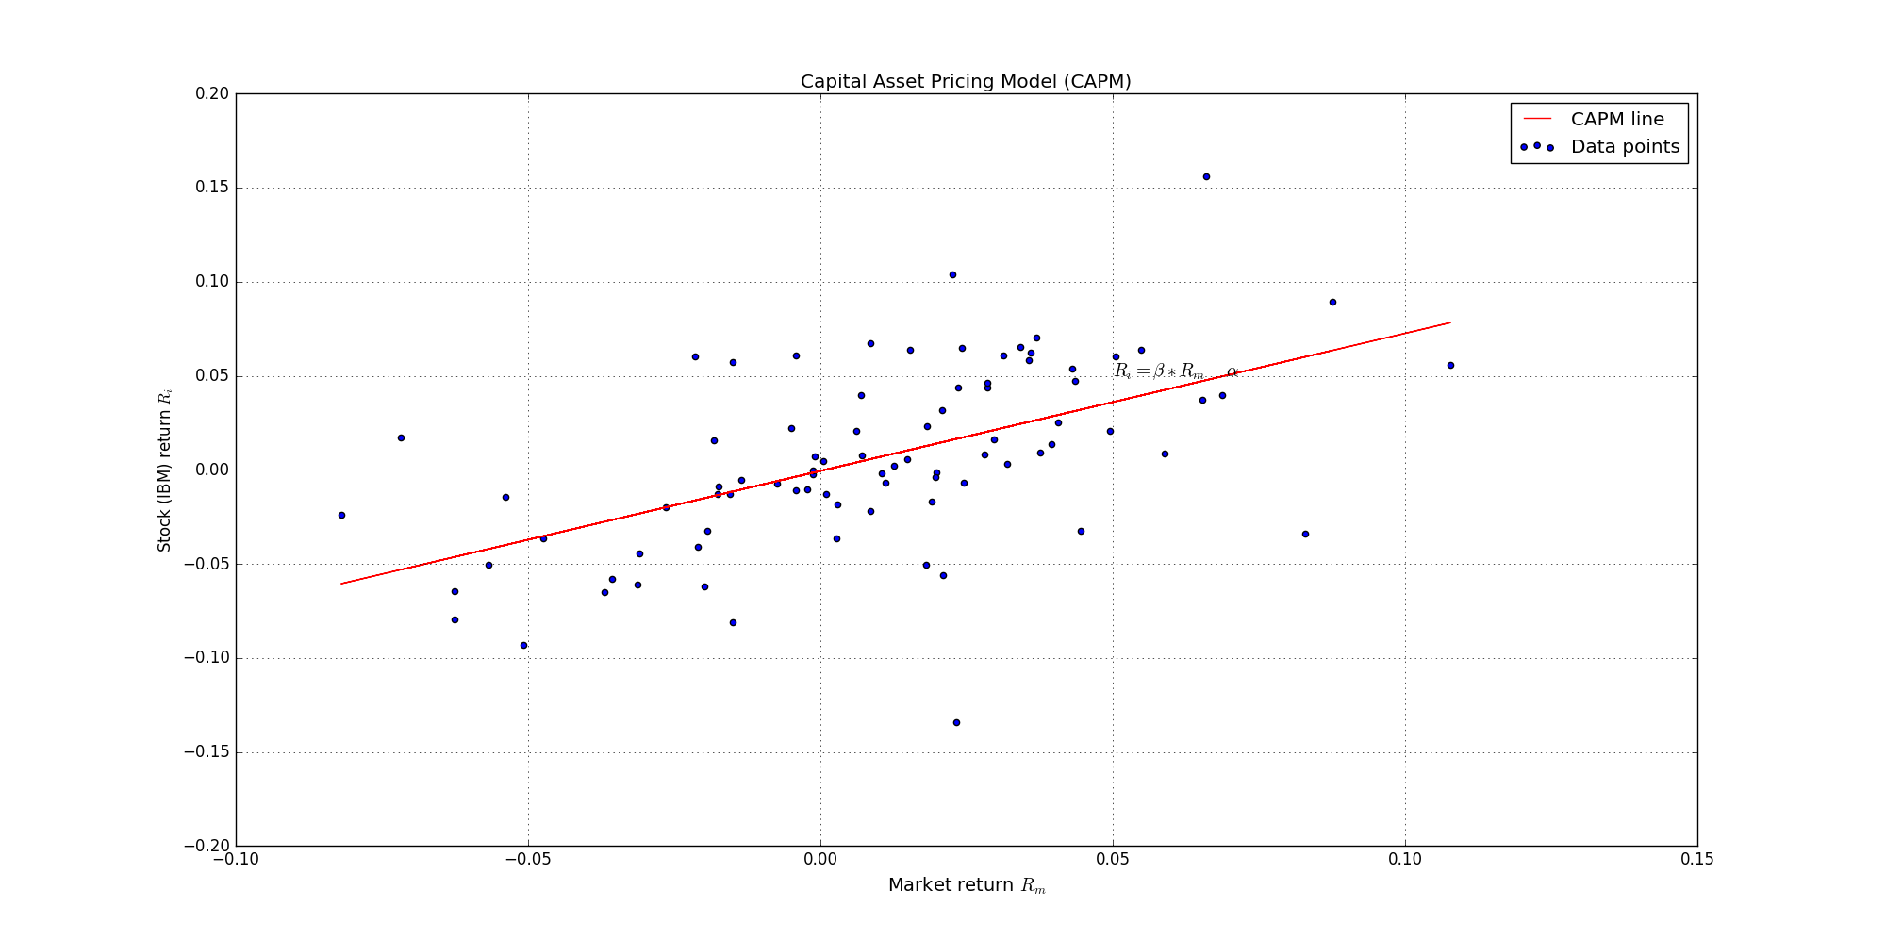
Capital Asset Pricing Model (CAPM)
E[r ] - r = α + β ( E[r ] – r )
a
f
m
f

Slide 54
Capital Asset Pricing Model (CAPM)
Beta is the only relevant measure of risk: determines the additional
premium beyond the risk-free rate
What is α alpha?
So the difference between the return and the
expected return !!!
α = E[r ] - { r + β ( E[r ] – r ) }
a
f
a
m
f
For example: CAPM may estimate that a portfolio should earn 15%
but it actually earned 20%. In this case alpha is the
difference so 5% !!!
FOR CAPM ALPHA IS ZERO !!!

Slide 55
Capital Asset Pricing Model (CAPM)
β = 0.5
less volatile than the market
Stock market goes up by 10% → this stock goes up by 5%
Stock market falls by 2% → this stock falls by 1%
β = 1.5
50% more volatile than the market
Stock market goes up by 10% → this stock goes up by 15%
Stock market falls by 2% → this stock falls by 3%

Slide 56
Capital Asset Pricing Model (CAPM)
Why to use monthly returns?
use daily returns if you want to deal with microscopic data
For example: holidays ...
Daily returns are superior for short-term
tactical forecasting !!!
for long-term models monthly returns are favourable
The main benefit is that with monthy data, returns
are at least approximately normally distributed
MOST OF THE MODELS ASSUME NORMAL DISTRIBUTION !!!

Slide 57
Capital Asset Pricing Model (CAPM)
What is Adj Close exactly?
It means Adjusted Closing Price !!!
→ the Closing Price of a stock is the actual price at
the close of the trading day
→ Adjusted Closing Price has something to do with
Closing Price BUT it takes into account factors
such as dividends, stock splits ...
ADJUSTED CLOSE PRICE IS A MORE ACCURATE REFLECTION OF THE STOCK’S VALUE !!!

Slide 58
Derivatives
A derivative is a security with a price that is derived from one or
more underlying assets
VALUE OF THE DERIVATIVE IS DETERMINED BY FLUCTUATIONS
IN THE UNDERLYING ASSET !!!
Underlying assets: stocks, currencies or interest rates
derivatives can be used to ensure balanced exchange rates for
goods traded internationally
International traders needed a system of accounting for
differing values of different national currencies
derivatives can be used for insuring againts risk in an asset (hedging)

Slide 59
Derivatives
1.) Future Contracts: it is an agreement between two parties for the
sale of an asset at an agreed upon price
Why is it good? In order to hedge againts risk during a given
period of time
For example: Tom owns 5000 shares of IBM with value $50 per share. Fearing that
the value of his shares would decline, Tom arranges a future contact to
protect the value of his stocks. Bob on the other hand speculates that
IBM stocks will rise in value. So they agree that in 1 year’s time Bob will
buy Tom’s 5000 shares at their current value of $50 !!!

Slide 60
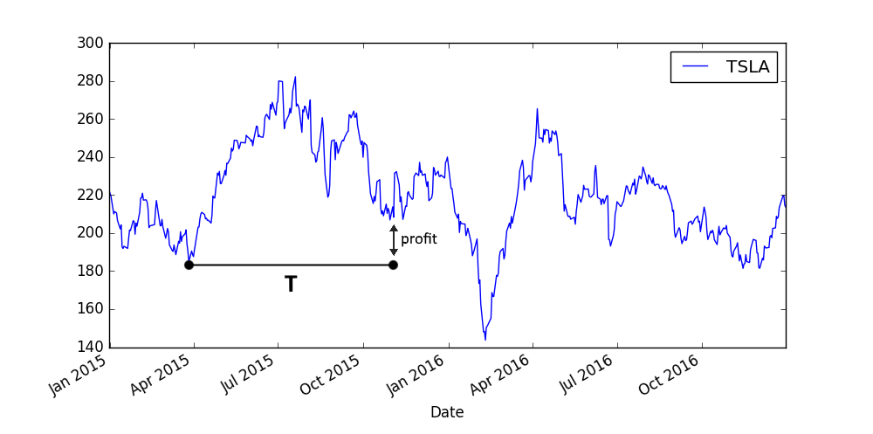
Derivatives
1.) Future Contracts: it is an agreement between two parties for the
sale of an asset at an agreed upon price

Slide 61
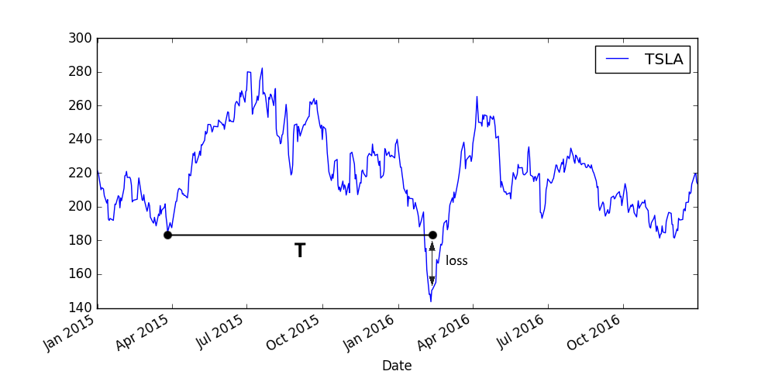
Derivatives
1.) Future Contracts: it is an agreement between two parties for the
sale of an asset at an agreed upon price

Slide 62
Derivatives
2.) Interest Rate Swaps: basically the swap of future interest payments
Agreement between two parties in which one stream of future
interest payments is exchanged for another !!!
For example: fixed interest rate for a floating interest rate
or vice versa
Why is it good? In order to reduce or increase exposure
to fluctuations in interest rates
(earn income through speculation)

Slide 63
Derivatives
2.) Interest Rate Swaps: basically the swap of future interest payments
Agreement between two parties in which one stream of future
interest payments is exchanged for another !!!
PAYER
agrees to pay a fixed-rate interest
RECEIVER
agrees to pay floating-rate interest
~ they agree to make payments to each other according to the rise and fall
of the floating interest rate
Rate(t)
payer benefits if interest rate goes up: receiver
pays the difference between fixed rate and
the floating rate !!!
t

Slide 64
Derivatives
2.) Interest Rate Swaps: basically the swap of future interest payments
Agreement between two parties in which one stream of future
interest payments is exchanged for another !!!
PAYER
agrees to pay a fixed-rate interest
RECEIVER
agrees to pay floating-rate interest
~ they agree to make payments to each other according to the rise and fall
of the floating interest rate
Rate(t)
receiver benefits if interest rate falls: payer
pays the difference between fixed rate and
the floating rate !!!
t

Slide 65
Derivatives
3.) Options: it is very similar to future contracts
For future contracts, the holder of the contract is obliged
to trade the maturity of the contract
For options: the option gives the holder the right to trade in the
future at a previously agreed price
BUT NO OBLIGATIONS AT ALL !!!
~ so it the stock falls, we do not have to buy it after all

Slide 66
Derivatives
3.) Options: it is very similar to future contracts
For future contracts, the holder of the contract is obliged
to trade the maturity of the contract
For options: the option gives the holder the right to trade in the
future at a previously agreed price
Value(t)
investor makes a profit because
the actual price is higher
T
t

Slide 67
Derivatives
3.) Options: it is very similar to future contracts
For future contracts, the holder of the contract is obliged
to trade the maturity of the contract
For options: the option gives the holder the right to trade in the
future at a previously agreed price
Value(t)
investor does not buy the stock
because option is just the right not
the obligation to buy !!!
T
t

Slide 68
Derivatives
3.) Options: it is very similar to future contracts
For future contracts, the holder of the contract is obliged
to trade the maturity of the contract
For options: the option gives the holder the right to trade in the
future at a previously agreed price
Value(t)
How to calculate the price of an option?
With Black-Scholes model !!!
T
t

Slide 69
Derivatives
3.) Options: the option gives the holder the right to trade in the
future at a previously agreed price
Call option: this is the right to buy a particular asset (stock) for an agreed
amount at a specific time in the future
For example: you can buy a call option on IBM. It gives the right to buy
one IBM stock for $30 in 1 month’s time. Today’s price is $25
Exercise price / strike price: E = $30
Expriation date / expiry: T = 1 month’s time (when we can buy the underlying)
The actual stock price: it is changing all the time S(t) ... S(t=0)=$25
max(S-E,0) this is what the call option worth at expiry
FOR A CALL OPTION: WE SPECULATE THAT THE STOCK WILL RISE

Slide 70
Derivatives
3.) Options: the option gives the holder the right to trade in the
future at a previously agreed price
value of
the option
V(S,T)
Payoff-diagram for a call option !!!
S(t) = E
S(t)
actual price
of stock
negative because we
pay for the option

Slide 71
Derivatives
3.) Options: the option gives the holder the right to trade in the
future at a previously agreed price
Put option: this is the right to sell a particular asset (stock) for an agreed
amount at a specific time in the future
For example: you can buy a put option on IBM. It gives the right to sell
one IBM stock for $30 in 1 month’s time. Today’s price is $25
Exercise price / strike price: E = $30
Expriation date / expiry: T = 1 month’s time (when we can buy the underlying)
The actual stock price: it is changing all the time S(t) ... S(t=0)=$25
max(E-S,0) this is what the put option worth at expiry
FOR A PUT OPTION: WE SPECULATE THAT THE STOCK WILL FALL

Slide 72
Derivatives
3.) Options: the option gives the holder the right to trade in the
future at a previously agreed price
Put option: this is the right to sell a particular asset (stock) for an agreed
amount at a specific time in the future
Value(t)
Value(t)
T
T
t
t
this is how you can make
money with put options
you would loose money: you
do not sell the underlying

Slide 73
Derivatives
3.) Options: the option gives the holder the right to trade in the
future at a previously agreed price
value of
the option
V(S,T)
Payoff-diagram for a put option !!!
S(t) = E
S(t)
actual price
of stock
negative because we
pay for the option

Slide 74
Derivatives
3.) Options: the option gives the holder the right to trade in the
future at a previously agreed price
we know the V(S,t) value of the option at expiry so
when t=T. But what if t<T?
we know for sure that the V(S,t) option value depends on
the undelying stock S(t) value and time t
American and European options:
1.) American Option: may be exercised at any t<T time
before expiration date
2.) European Option: this type of option can be exercised only at
the expiration date !!!

Slide 75
Random behaviour
There are three important forms of analysis in finance:
1.) fundamental analysis
2.) technical analysis
3.) quantitative analysis

Slide 76
Random behaviour
1.) fundamental analysis
Fundamental analysis is about in-depth study of the given company
~ management teams, product/service,
balance sheets, competitors ...
We take these factors → and predict the stock price according
to the „intrinsic value” of a company
IT IS EXTREMELY HARD TO DO !!!
We may have a good model for the value of a given company: we can not
make money. Rest of the world should see the mispricings
as well and this may never happen !!!

Slide 77
Random behaviour
2.) technical analysis
It is a opposite of fundamental analysis: this approach does not
care about the company
~ all the information is contained within its stock
TECHNICAL ANALYSIS IS ABOUT HISTORICAL DATA !!!
we have to analyse historical data, look for specific
patterns in the share price to make predictions accordingly
For example: machine learning algorithms, neural networks

Slide 78
Random behaviour
3.) quantitative analysis
Quantitative analysis has an assumption: all financial quantities such as
stock prices or interest rates has random behavior
We have to use randomness in our models:
~ stochastic calculus and stochastic
differential equations are needed !!!

Slide 79
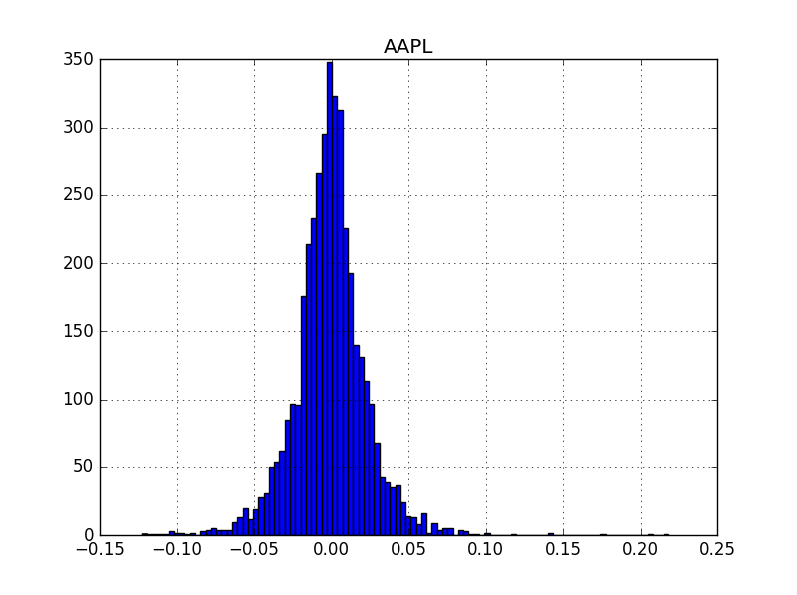
Random behaviour
S(t+1) - S(t)
= R(t) return in the interval [t,t+1]
S(t)
As we have seen the daily returns (monthly returns)
has approximately normal distribution !!!
normal distributions can be defined by two
parameters: mean and variance
so returns can be defined by these
parameters as well
R(t) = mean + x * standard deviation
~ we can define return as a random variable
drawn from a normal distribution

Slide 80
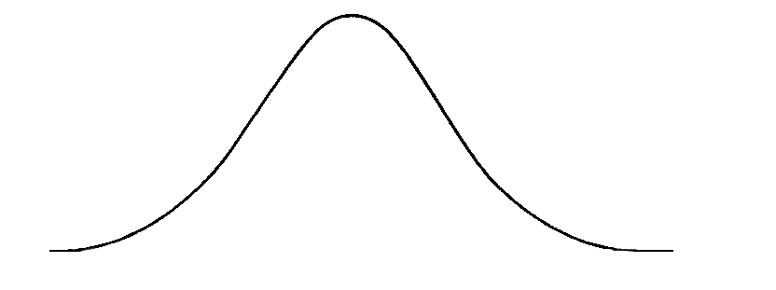
Random behaviour
R(t) = mean + x * standard deviation
~ we can define return as a random variable
drawn from a normal distribution
S(t)
Stock price S(t) can be described by a
W(t) random walk !!!
asset
tomorrow
W(t) has continuous sample path
It has independent and normally
distributed increments
asset today
t

Slide 81
Random behaviour
standard deviation
above the mean
S(t)
mean
standard deviation
below the mean
t

Slide 82
Random behaviour
Wiener-process:
W(t) has independent increments: future W(t+dt) – W(t)
increments are independent of past values
W(t) has Gaussian increments: W(t+dt)-W(t) is normally
distributed with mean 0 and variance dt
W(t+dt) – W(t) ~ N(0,dt)
S(t)
asset
tomorrow
Wiener-process W(t) has continuous paths !!!
asset today
t

Slide 83
Random behaviour
dS = 𝝻 S dt + 𝞂 S dX
this is the change in the
stock price: S(t+dt)-S(t)
deterministic part
„drift”
stochastic part
2
E[dX] = 0 and E[dX ] = dt
Basically dX is a random variable drawn from a normal distribution with
mean 0 and variance dt
THIS IS A STOCHASTIC DIFFERENTIAL EQUATION !!!
continuous model of asset prices
fundamental assumption for most of the modern
financial models

Slide 84
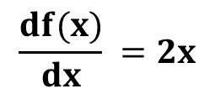

Stochastic calculus
Ordinary functions: with deterministic variables
2
f(x) = x what is the derivative of f(x)?
$$\frac{df(x)}{dx} =2x$$
df(x) = $\frac{df(x)}{dx} dx=2xdx$
Dealing with stochastic random variables: this
is not going to be true !!!

Slide 85


Stochastic calculus
Stochastic random variables:
If we have a function of a stochastic variable: for example
2
a brownian motion X(t) and the function F(X)=X
~ ordinary approach is not good: F(X) is stochastic !!!
2
dF(X) = $\frac{dF(X)}{dX} dX$ + $\frac{1}{2} \frac{d F(X)}{dX} dt$
„ITO’S LEMMA”
2
2
F(X+dX) = F(X) + $\frac{dF(X)}{dX} dX$ + $\frac{1}{2} \frac{d F(X)}{dX} dX$
2
we do not assume any stochastic behaviour
2
2
but we know that E[dX ] = dt and F(X+dX) – F(X) = dF(X)
So the solution: dF(X) = 2XdX + dt

Slide 86
Stochastic calculus
Stochastic random variables:
In quantitative finance a random stochastic
variable is the S(t) stock price
~ we can use Wiener-process as a model
dS(t) = a(S,t) dt + b(S,t) dX
If we have another variable V(S,t) depending on S(t) for example the
price of the option, what stochastic equation describes
the change in V(S,t) value?
HIGHER DIMENSIONAL ITO’S FORMULA IS NEEDED !!!

Slide 87










Stochastic calculus
Ito’s lemma in higher dimensions:
Suppose we have dS(t) = a(S,t) dt + b(S,t) dX. How to define the change
in V(S,t)? (S defines the underlying asset’s price, V is the option price)
$\frac{∂V}{∂S}\text{Δ}$S
2
2
2
$\frac{∂V}{∂t}\text{Δ}$t
$\frac{∂ V}{∂t}\text{Δ}$t
$\frac{∂ V}{∂S∂t}\text{Δ}$S $\text{Δ}\text{t}$
$\frac{∂ V}{∂S}\text{Δ}$S
+
+
$\frac{1}{2}\text{(}$ + 2 + )
V(S+𝛥S,t+𝛥t) = V(S,t) +
2
2
2
2
these terms are small so
we can omit them
2
$\frac{∂V}{∂t}$ dt
$\frac{∂V}{∂S}d$S
$\frac{∂ V}{∂S}d$S
+
+
$\frac{1}{2}$
dV(S,t) =
2
2
2
2
2
2
2
2
2
2
$d$S = ( a dt + b dX ) = a dt + 2 a b dt dX + b dX = b dX
these terms are small so
we can omit them

Slide 88




Stochastic calculus
Ito’s lemma in higher dimensions:
Suppose we have dS(t) = a(S,t) dt + b(S,t) dX. How to define the change
in V(S,t)? (S defines the underlying asset’s price, V is the option price)
2
2
2
2
2
2
2
2
$d$S = ( a dt + b dX ) = a dt + 2 a b dt dX + b dX = b dX
these terms are small so
we can omit them
2
2
E[dX ] = dt so dX ~ dt
$\frac{∂V}{∂S}d$S
2
$\frac{∂V}{∂t}$ dt
$\frac{∂ V}{∂S}d$t
$\frac{1}{2}$ b
dV(S,t) =
+
+
2
2
It is going to be crucial when dealing with Black-Scholes model !!!

Slide 89
Black-Scholes Model
It was published in 1973 by Fisher Black, Robert Merton and Myron Scholes
~ they were constructed a model that can yield the V(S,t) option
price when t<T
THEY SHOWED THAT COMBINING RISKY ASSETS
CAN ELIMINATE RISK ITSELF !!!
Modern Portfolio Theory is about including several stocks in
a portfolio in order to reduce unsystematic risk
CAPM is about β: because we can eliminate unsystematic risk, the
only relevant risk is market risk
~ market risk cannot be diversified away !!!
Market-neutral strategyies: delta-hedging and pairs-trading
can eliminate all risk !!!

Slide 90
Black-Scholes Model
The V(S,t,...) value of an option is a function of various parameters
V( S , t , σ , μ , E , T , r )
stock price and time
are variables
parameter associated with
risk-free rate
volatility and mean are
parameters associated
with the stock price
strike price and expiry
are parameters associated
with the given option

Slide 91
Black-Scholes Model
Call option: this is the right to buy a particular asset (stock) for an agreed
amount at a specific time in the future
call option will rise in value if the underlying asset rises and
fall if the asset falls
WHY? Of course, the greater the value of S(t) stock, the greater
the payoff at T expiry
POSITIVE CORRELATION BETWEEN TWO ASSETS !!!

Slide 92
Black-Scholes Model
Put option: this is the right to sell a particular asset (stock) for an agreed
amount at a specific time in the future
NEGATIVE CORRELATION BETWEEN TWO ASSETS !!!
we can exploit these correlations to end up with a
rather special portfolio
π = V(S,t) - 𝛥S
long position
short position
This special π portfolio contains a long position in the V(S,t) option
and a short position in the S(t) underlying stock
What is 𝛥? We short just some quantity of the underlying

Slide 93
Black-Scholes Model
Assumption: the underlying asset follows a lognormal random walk
dS = 𝝻 S dt + 𝞂 S dX
What about the change in the portfolio’s value?
The π portfolio changes from time t to t+dt: first of due to change in
the V(S,t) option value + because of the change in the S(t)
underlying asset
dπ = dV(S,t) - 𝛥dS
How to deal with these changes? With the help of Ito’s lemma
we can handle these changes

Slide 94












Black-Scholes Model
2
$\frac{∂V}{∂t}$ dt
$\frac{∂V}{∂S}d$S
$\frac{∂ V}{∂S}d$t
+
+
$\frac{1}{2}$ σ S
dV(S,t) =
2
2
2
2
$\frac{∂V}{∂S}d$S
$\frac{∂ V}{∂S}d$t
$\frac{∂V}{∂t}$ dt
+
+
$\frac{1}{2}$ σ S
+
2
2
dπ = - 𝛥dS
2
2
$$\frac{∂V}{∂S}$$
$\frac{∂ V}{∂S} )d$t
( $\frac{∂V}{∂t}$
$\frac{1}{2}$ σ S
+
+
+
2
2
dπ = ( - 𝛥)dS
2
deterministic part
stochastic part

Slide 95



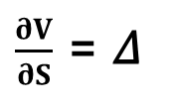

Black-Scholes Model
Delta-hedging:
The change in the portfolio has a deterministic part and a
stochastic part
2
$$\frac{∂V}{∂S}$$
$\frac{∂ V}{∂S} )d$t
( $\frac{∂V}{∂t}$
$\frac{1}{2}$ σ S
+
+
+
2
2
dπ = ( - 𝛥)dS
2
deterministic part
stochastic part
$\frac{∂V}{∂S}$ = 𝛥
if we choose delta like this, risk
is reduced to zero
any elimination in randomness is called hedging
delta hedging: the perfect elimination of risk because of
exploiting the correlation between two assets
~ it is an example of dynamic hedging

Slide 96

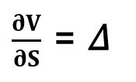



Black-Scholes Model
Delta-hedging:
$\frac{∂V}{∂S}$ = 𝛥
„dynamic delta-hedging”
Of course this 𝛥 is changing all the time: the perfect hedge must be
continually rebalanced
2
$$\frac{∂V}{∂S}$$
$\frac{∂ V}{∂S} )d$t
( $\frac{∂V}{∂t}$
$\frac{1}{2}$ σ S
+
+
+
2
2
dπ = ( - 𝛥)dS
2
deterministic part
stochastic part
so we just have to deal with the
deterministic part exclusively

Slide 97



Black-Scholes Model
No arbitrage principle:
We can use dynamic hedging to eliminate all the risk
~ we have just the deterministic part
2
$\frac{∂ V}{∂S} )d$t
( $\frac{∂V}{∂t}$
$\frac{1}{2}$ σ S
+
+
2
2
dπ =
2
This change is completely riskless: but risk-free asset has
something to do with r risk-free rate
The risk-free dπ change must be the same as the growth we would get if we
lend the same amount of cast to a bank:
dπ = r π dt
„no arbitrage principle”

Slide 98
Black-Scholes Model
No arbitrage principle:
Let’s consider it is not true: why can we make a riskless profit?
Arbitrage: when the investor can make riskless money !!!
if we can get a greater return with the delta-hedged portfolio: we
could borrow money from the bank ... pay interest at rate r
invest that money into risk-free option/stock portfolio
and we could make a profit !!!
usually we can assume there are no arbitrage opportunities
OR if there are ... just for a very short time !!!

Slide 99








Black-Scholes Model
2
$$\frac{∂V}{∂S}$$
$\frac{∂ V}{∂S} )d$t = r ( V – S ) dt
( $\frac{∂V}{∂t}$
$\frac{1}{2}$ σ S
+
+
2
2
2
2
$$\frac{∂V}{∂S}$$
$\frac{∂ V}{∂S}$– r S
$\frac{∂V}{∂t}$
+
$\frac{1}{2}$ σ S
+
2
2
- r V = 0
2
„Black-Scholes equation”
it is a parabolic partial differential equation
linear: so the sum of the solutions is also a solution
financial equations are usually parabolic: they are related to heat
and diffusion equations of physics !!!

Slide 100



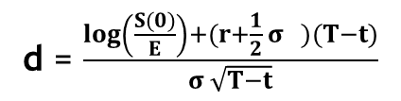
Black-Scholes Model
Solution to Black-Scholes equation: no dividend yields on the underlying
$$\int_{−∞}^{x}{e^{−\frac{z}{2}}}$$
$$\frac{1}{\sqrt{2π}}$$
2
N(x) =
dz
standard normal distribution
CALL OPTION PUT OPTION
-r(T-t)
-r(T-t)
S(0)N(d ) – E e N(d )
-S(0)N(-d ) + E e N(-d )
1
2
1
2
d = $\frac{\log\left(\frac{S(0)}{E}\right)+(r+\frac{1}{2} σ )(T−t)}{σ \sqrt{T−t}}$
2
1
d = d – σ $\sqrt{T−t}$
2
1

Slide 101

The Greeks
1.) Delta: 𝛥
The delta of an option/portfolio is the sensitivity of the
option/portfolio to the underlying
𝛥$= \frac{∂V}{∂S}$
~ the delta of a portfolio is the sum of deltas of
all individual positions
it is important when dealing with delta-hedging
We can eliminate risk if we make sure delta is
equals to the derivative !!!

Slide 102

The Greeks
2.) Gamma: 𝛤
The gamma of an option/portfolio is second derivative of the
position with respect to the underlying
2
𝛤$= \frac{∂ V}{∂S }$
2
~ basically it is the sensitivity of 𝛥 delta
gamma is a measure of how often a position must be rehedged in
order to maintain a delta-neural position
Delta-neutral: it means the portfolio value remains unchanged when small
changes occur in the value of the underlying
This is what Black-Scholes model about !!!

Slide 103


The Greeks
3.) Theta: 𝛩
Theta is the rate of change of the option price with time:
𝛩$=\frac{∂V}{∂t}$
4.) Vega:
Some models rely heavily on the volatility so it may be important
to monitor the change according to volatility
$\frac{∂V}{∂σ}$

Slide 104

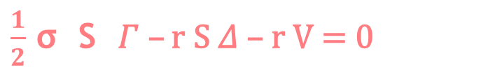

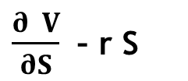
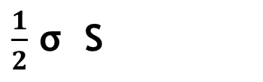
The Greeks
Black-Scholes formula:
2
$$\frac{∂V}{∂S}$$
$\frac{∂ V}{∂S}$– r S
$\frac{∂V}{∂t}$
$\frac{1}{2}$ σ S
+
+
2
2
- r V = 0
2
theta
gamma
delta
$\frac{1}{2}$ σ S 𝛤 – r S 𝛥 – r V = 0
2
𝛩 +
2
„Black-Scholes formula with the greeks”

Slide 105
Implied Volatility
Most of the parameters are straightforward when dealing
with the Black-Scholes model
V(S,t,σ,μ,E,T,r)
HOW TO CALCULATE VOLATILITY?
→ volatility has something to do with the option price
What volatility should the investor use to get the correct market price
of the given option? This is called implied-volatility !!!
We have to solve the Black-Scholes equation:
V (S,t,σ,μ,E,T,r) = known value
Black-Scholes
We can use Newton-Raphson method to find σ

Slide 106
Black-Scholes Model
How to make money with Black-Scholes model?
several investors use these kinds of models to
eliminate risk
So calculate the greeks to hedge a given portfolio
→ you can use Black-Scholes model to find mispriced options
in the market
~ you can buy or sell accordingly to make a profit

Slide 107
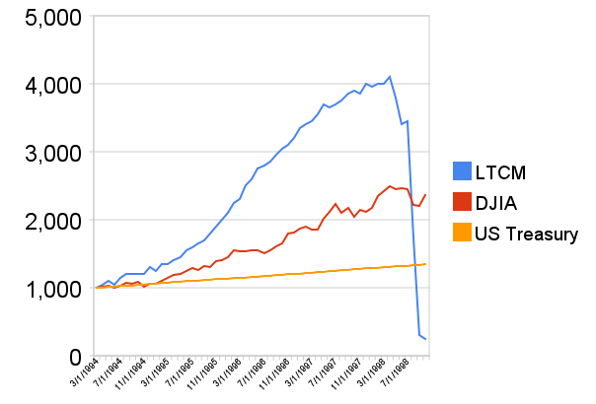
Long Term Capital Management (LTCM)
this hedge fund was founded in 1994 by the former vice-chairman
of Salomon Brothers – John W. Meriwether
lots of members were academics: such as the Nobel-prize winner
Myron Scholes and Robert C. Merton
~ they used quite complex models such as paris-trading or
Black-Scholes model !!!

Slide 108
Long Term Capital Management (LTCM)
Because of the asian financial crisis in 1997 and
the russian financial crisis in 1998 LTCM collapsed
What as the key of success?
The quants in LTCM tried to hedge market risk
There are two approaches: Black-Scholes model
and pairs-trading strategy
MARKET-NEUTRAL STRATEGIES !!!
market-neutral strategy tries to profit from both increasing
and decreasing stock prices
usually combining long and short positions
in different assets

Slide 109
Long Term Capital Management (LTCM)
Pairs-trading strategy:
Combining long and short positions in a pair of highly correlated
financial instruments (such as stocks)
~ it is a form of statistical-arbitrage strategy
developed in the 1980s
If the correlation between the two stocks weakens: investor should long the
underperforming stock and short the outperforming stock → because they are
expected to converge in the future
For example: CocaCola and Pepsi
~ they have similar business idea so they are similar

Slide 110
Long Term Capital Management (LTCM)
Pairs-trading strategy:
Combining long and short positions in a pair of highly correlated
financial instruments (such as stocks)
~ it is a form of statistical-arbitrage strategy
developed in the 1980s
S(t)
Pepsi (PEP) and CocaCola (KO) are companies
with similar products: they are historically correlated
If PEP goes up a significant amount while KO stays the same,
pairs trader should buy KO stock and sell PEP stock
~ so the trader assumes the companies would return
to their historical balance point
Coca-Cola
Pepsi
t

Slide 111
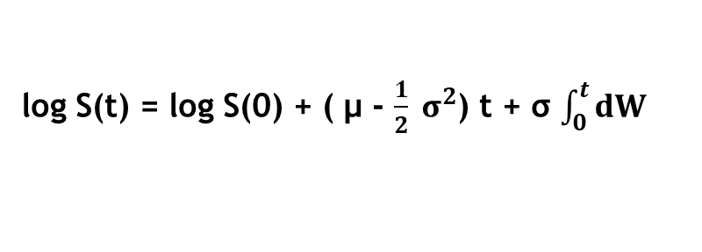

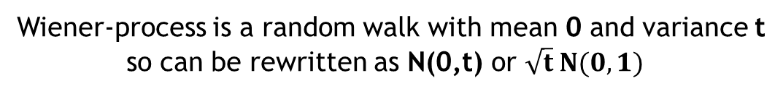
Monte-Carlo Simulation
For an option: the underlying asset (stock) follows
a Wiener-process or Brownian-motion
→ so by simulating these stochastic processes we can determine
the price of financial instruments (option)
dS(t) = μ S(t) dt + σ S(t) dW
We can obtain the log S(t) because we know that stock prices
can not be negative. So let’s use Ito’s lemma with F(S) = log S(t)
d log S(t) = ( μ - $\frac{1}{2} σ^{2}$)dt + σ dW
log S(t) = log S(0) + ( μ - $\frac{1}{2} σ^{2}$) t + σ $\int_{0}^{t}{dW}$
Wiener-process is a random walk with mean 0 and variance t
so can be rewritten as N(0,t) or $\sqrt{t} N(0,1)$

Slide 112

Monte-Carlo Simulation
If we make a risk-neutral assumption: the μ drift becomes
the r risk-free interest rate
S(T) = S(0) $e^{\text{[(} \text{r}\text{ − }\frac{1}{2} σ^{2}\text{)}\text{t}\text{ + }\text{σ}\sqrt{T} \text{N}\text{(0,1)]}}$
~ this exponential function defines the stock
price at T maturity
in Monte-Carlo simulation we generate a large amount of stock
price estimates with this equation
the option price is the expected value of a pay-off function
+ we have to use a discounted factor (time value of money)
max(S-E,0) max(E-S,0)
call option put option

Slide 113
Value at Risk (VaR)
There is a trade-off between risk and return
~ conclusion of Modern Portfolio Theory and CAPM
→ measuring return is quite straightforward
→ but what about risk?
There are several measures: variance, standard deviation to measure
total risk + beta to measure market risk ...
THESE MEASURES DO NOT CONSIDER A PROBABILITY DISTRIBUTION !!!
There is another measure with this feature: Value at Risk (VaR)

Slide 114
Value at Risk (VaR)
S(t+1) - S(t)
= R(t) return in the interval [t,t+1]
S(t)
As we have seen the daily returns (monthly returns)
has approximately normal distribution !!!
normal distributions can be defined by two
parameters: mean and variance
so returns can be defined by these
parameters as well
R(t) = mean + x * standard deviation
~ we can define return as a random variable
drawn from a normal distribution

Slide 115
Value at Risk (VaR)
1.) VaR is a number measure in price units
It tells you that in a large percetage of cases your portfolio is
likely to not lose more than that amount of money
„VaR measures the amount of potential loss that could happen
in an investment (or a portfolio of investments)
over a given period of time (with a given
degree of confidence)”
2.) easy to understand and easy to interpret
Standard deviation or beta is not that straightforward
3.) you can compare different types of assets or portfolios with VaR
You can compare profitability and risk of different units and
make a decision accordingly
„risk budgeting”

Slide 116
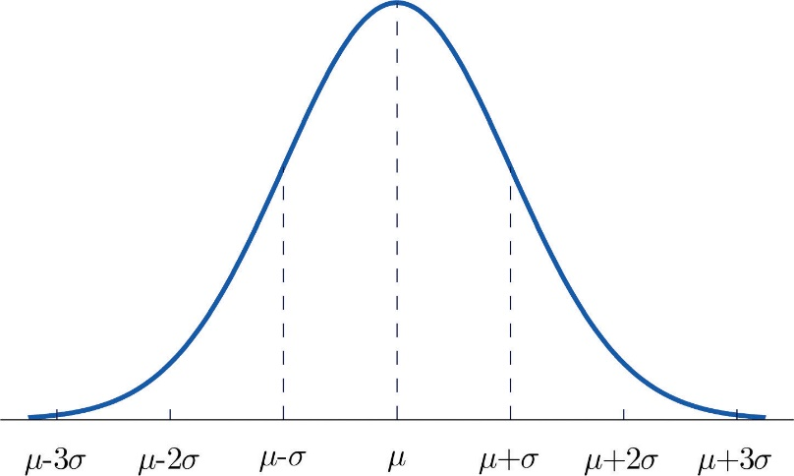
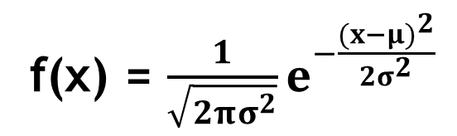
Value at Risk (VaR)
Variance method: assumes returns are normally distributed
We are after something like this: on february 10, 2017, we own 100 shares
of Appla (AAPL). The maximum loss tomorrow is $1750 with 99%
confidence level
The density of normal distribution function is important:
f(x) = $\frac{1}{\sqrt{2πσ^{2}}}e^{−\frac{{(x−μ)}^{2}}{2σ^{2}}}$

Slide 117
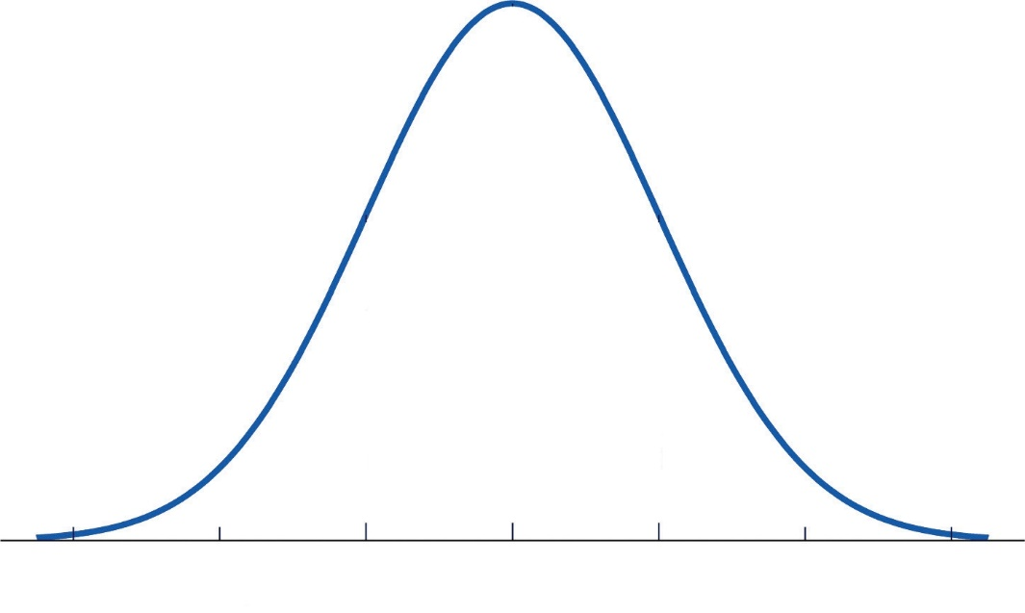
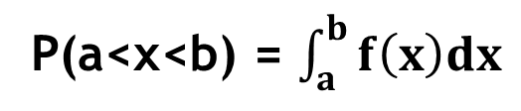
Value at Risk (VaR)
The density function is closely related to probability
~ the integral of the function yields the probability
P(a<x<b) = $\int_{a}^{b}{f\left(x\right)dx}$
a b
the definite integral is the area under
the bell-shaped curve

Slide 118
Value at Risk (VaR)
We would like to make sure the loss is not going to be greater than
a predefined value
Prob{ δπ < -$5million } = 0.05 (if the confidence level is 95%)
Prob{ δπ < -VaR} = 1-c
z defines the number of standard
deviations from the mean:
99% confidence level → z=2.33
95% confidence level → z=1.64
z
this is the probability of losing some money: this is what we are after
~ this area is 0.01 for 99% degree of confidence and 0.05 for
95% confidence level !!!

Slide 119

Value at Risk (VaR)
We would like to make sure the loss is not going to be greater than
a predefined value
Prob{ δπ < -$5million } = 0.05 (if the confidence level is 95%)
Prob{ δπ < -VaR} = 1-c
-----------------------------------------------------------
VaR = position ( μ - z σ )
period
period
We have another problem to deal with: the mean and the variance
applied to the daily returns! But the time interval for VaR is
not necessary 1 day ...
σ = σ $\sqrt{n}$
n-day
daily
μ = μ n
n-day
daily

Slide 120

Value at Risk (VaR)
We would like to make sure the loss is not going to be greater than
a predefined value
Prob{ δπ < -$5million } = 0.05 (if the confidence level is 95%)
Prob{ δπ < -VaR} = 1-c
-----------------------------------------------------------
VaR = 𝛥S [ μ δt - σ $\sqrt{\text{δ}\text{t}}$ α(1-c) ]
if we calculate VaR for tomorrow: so δt is small, we can omit
the μ term
if we calculate VaR for longer periods (years): we have to take
drift into consideration as well
α(1-c) is the inverse cumulative distribution function for
the standardized normal distribution

Slide 121
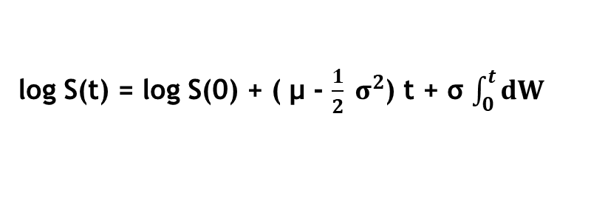

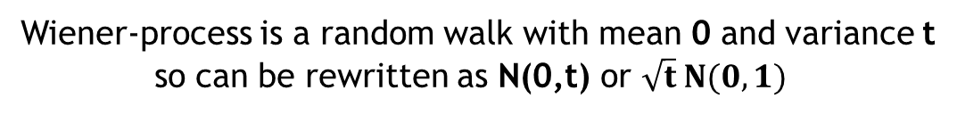
Value at Risk – Monte-Carlo approach
Stock prices follow a Wiener-process or Brownian-motion
dS(t) = μ S(t) dt + σ S(t) dW
We can obtain the log S(t) because we know that stock prices
can not be negative. So let’s use Ito’s lemma with F(S) = log S(t)
d log S(t) = ( μ - $\frac{1}{2} σ^{2}$)dt + σ dW
log S(t) = log S(0) + ( μ - $\frac{1}{2} σ^{2}$) t + σ $\int_{0}^{t}{dW}$
Wiener-process is a random walk with mean 0 and variance t
so can be rewritten as N(0,t) or $\sqrt{t} N(0,1)$

Slide 122

Value at Risk – Monte-Carlo approach
Solution of this stochastic differential equation:
S(t) = S(0) $e^{\text{[(}μ \text{− }\frac{1}{2} σ^{2}\text{)}\text{t}\text{ + }\text{σ}\sqrt{t} \text{N}\text{(0,1)]}}$
~ this exponential function defines the stock
price at a given t time
in Monte-Carlo simulation we generate a large amount of stock
price estimates with this equation
we have to sort the stock prices from the smallest to the largest
If we need the VaR with 99% confidence level: we need the 1%
lowest percentile S’(t) in this series
~ because there is 1% chance that S(t) could fall to S’(t) or less
VaR = S(t) – S’(t)
99%

Slide 123
Long Term Investing
Algorithmic trading is about making money quickly: using quantitative
methods to outperform the market !!!
Value investing: Benjamin Graham’s and Warren Buffet’s strategy
this is a strategy where stocks are selected that
trade for less than their intrinsic value
so stocks that are considered to be
undervalued by the market
value investors believe the market overreacts to news
(whether bad or good news): resulting in stock price
movements that do not correspond with a company’s
long-term fundamentals !!!

Slide 124
Long Term Investing
value investors have the tendency to invest in companies
not in stocks !!!
~ companies with good long-term prospects
value investors buy stocks when the market price is significantly
below the underlying value
value investing is a long-term investing - „buy and hold”
No short-term trends + no quantitative methods to hedge risk
no machine learning techniques to make money on
short-term mispricings !!!
value investors ignore the crowd: most people buy shares when
the given stock price arises + sell when prices decline
„buy high sell low behaviour”
Value investors decide whether to buy or sell according to the
relationship between the value and the price of the stock

Slide 125
Efficient Market Hypothesis
„It is impossible to beat the market”
because stock market efficiency causes existing stock
prices to always reflect all relevant information
according to Efficient Market Hypothesis stocks always trade at
their fair value: making it impossible for investors to buy
undervalued stocks
so it is impossible to outperform the market with stock selection
or market timing
THE ONLY WAY AN INVESTOR CAN OBTAIN HIGHER RETURNS IS TO TAKE MORE RISK !!!

Slide 126
Machine learning
What is machine learning?
It as an application of artificial intelligence (AI) that provides a system
the ability to automatically learn without being explicitly programmed
graph algorithms, numerical computations etc.: we know the
exact algorithm: we implement in in Java, C++ or Python
machine learning approach: we provide data to an algorithm and
the algorithm itself finds out the relationship
between the features

Slide 127
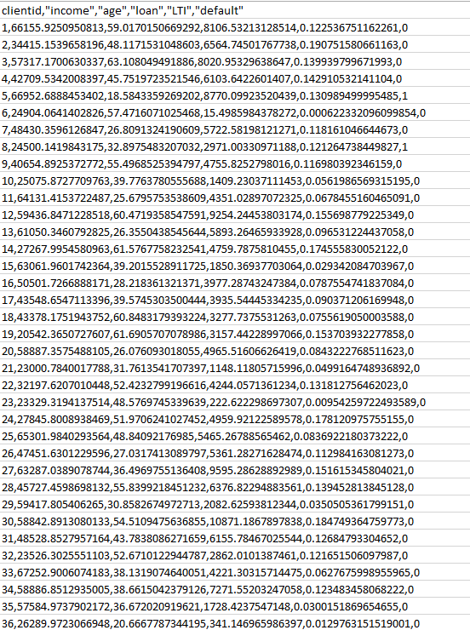
Machine learning
Credit scoring in insurance companies:
We have a huge dataset about the clients
~ these are called „features”: age, income...
+ whether the client has defaulted or not
WE TRAIN OUR MACHINE LEARNING ALGORITHM ON THIS DATASET
learns the relationship between the features
when there is a new client with all the
parameters: the algorithm can decide
whether he/she will be able
to pay back the loan !!!

Slide 128
Machine learning
Credit scoring in insurance companies:
loan
income

Slide 129
Machine learning
Credit scoring in insurance companies:
loan
?
income

Slide 130


Machine learning
Facebook Ad Manager: machine learning algorithm as well
→ Facebook learns from data
(thats why to wait for 2-3 days)
→ Facebook learns the interests and profile
of people taking action
(add to cart or purchase)
→ Facebook tries to find similar people in
your targeted audience
THIS IS WHY TO USE PIXEL !!!
AUDIENCE

Slide 131
Machine learning
Predicting stock prices:
S(t)
t

Slide 132
Machine learning
Predicting stock prices:
Lag #1
Lag #2
Lag #3
DIRECTION
S(t)
t

Slide 133
Machine learning
Predicting stock prices:
Lag #1
Lag #2
Lag #3
DIRECTION
S(t)
r11
r12
r13
t

Slide 134
Machine learning
Predicting stock prices:
Lag #1
Lag #2
Lag #3
DIRECTION
S(t)
r11
r12
r13
UP
t

Slide 135
Machine learning
Predicting stock prices:
Lag #1
Lag #2
Lag #3
DIRECTION
S(t)
r11
r12
r13
UP
r21
r22
r23
t

Slide 136
Machine learning
Predicting stock prices:
Lag #1
Lag #2
Lag #3
DIRECTION
S(t)
r11
r12
r13
UP
r21
r22
r23
UP
t

Slide 137
Machine learning
Predicting stock prices:
Lag #1
Lag #2
Lag #3
DIRECTION
S(t)
r11
r12
r13
UP
r21
r22
r23
UP
r21
r22
r23
t

Slide 138
Machine learning
Predicting stock prices:
Lag #1
Lag #2
Lag #3
DIRECTION
S(t)
r11
r12
r13
UP
r21
r22
r23
UP
r21
r22
r23
DOWN
t

Slide 139
Machine learning
Predicting stock prices:
Lag #1
Lag #2
Lag #3
DIRECTION
S(t)
r11
r12
r13
UP
r21
r22
r23
UP
r21
r22
r23
DOWN
.
.
.
.
.
.
.
.
.
.
.
.
t

Slide 140
Machine learning
Predicting stock prices:
Lag #1
Lag #2
Lag #3
DIRECTION
S(t)
r11
r12
r13
UP
r21
r22
r23
UP
r21
r22
r23
DOWN
.
.
.
.
.
.
.
.
.
.
.
.
r91
r92
r93
???
t

Slide 141
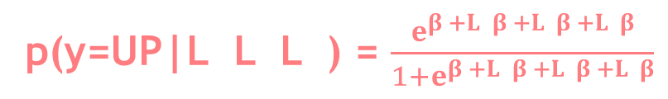
Logistic Regression
We have the features: the lagged percentage returns of a given stock
+ we have a categorical dependent variable: direction (up/down)
logistic regression provides a probability
p(y=UP|L L L ) = $\frac{e^{β +L β +L β +L β}}{1+e^{β +L β +L β +L β}}$
0
1 1
2 2
3 3
„logistic function”
1
2
3
0
1 1
2 2
3 3
~ it yields the probability for having an UP day given that we
have the previous time period’s returns
linear regression is not working this time: we are after probabilities
between [0,1] for all values of L
~ with linear regression we would obtain negative
values as well

Slide 142
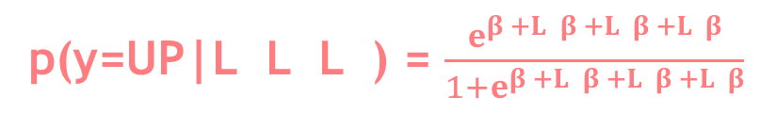
Logistic Regression
p(y=UP|L L L ) = $\frac{e^{β +L β +L β +L β}}{1+e^{β +L β +L β +L β}}$
0
1 1
2 2
3 3
„logistic function”
1
2
3
0
1 1
2 2
3 3
What are these β values?
this is what we are after: fitting the model means
finding the β coefficients
there are several methods to find these values: with
gradient descent or maximum likelihood method

Slide 143
K-Nearest Neighbor Classifier
K-nearest neighbors classifiers can classify examples by assigning them the class of the most similar labeled examples
very simple BUT extremely powerful algorithm !!!
kNN is well suited for classification tasks where the relationship between the features are very complex and hard to understand
we have a training dataset → examples that are classified into several categories
we have a new example: (with the same number of features as the training data) → kNN algorithm identifies k elements in the training dataset that are the „nearest” in similarity
the unlabeled test example is assigned to the class of the majority of the k nearest neighbors

Slide 144
K-Nearest Neighbor Classifier
ingredients
sweetness
crunchiness
type
apple 10 9 fruit
bacon 1 4 protein
banana 10 1 fruit
carrot 7 10 vegetable
cheese 1 1 protein
tomato 6 4 ???

Slide 145
K-Nearest Neighbor Classifier
crunchiness
carrot
cucumber
apple
bacon
orange
fish
banana
cheese
sweetness

Slide 146
K-Nearest Neighbor Classifier
crunchiness
carrot
cucumber
apple
bacon
orange
fish
banana
cheese
sweetness

Slide 147
K-Nearest Neighbor Classifier
crunchiness
carrot
cucumber
apple
tomato
bacon
orange
fish
banana
cheese
sweetness

Slide 148

K-Nearest Neighbor Classifier
dist(x,y) =
$\sqrt{{ {(x−y )}^{2}+(x−y )}^{2}+…{+(x−y )}^{\begin{aligned}2 \\ \end{aligned}}}$
1
1
2
2
n
n
we have to calculate the distances between ‚tomato’ and
all the other items in the dataset
„Euclidean-distance”
k is a parameter when dealing with kNN: the algorithm uses
the k closest training example in the feature space
to make a decision

Slide 149





K-Nearest Neighbor Classifier
dist(tomato,carrot) =
$\sqrt{{ {(6−7)}^{2}+(4−10)}^{2}}$ = 6.083
dist(tomato,apple) =
$\sqrt{{ {(6−10)}^{2}+(4−9)}^{2}}$ = 6.403
dist(tomato,bacon) =
$\sqrt{{ {(6−1)}^{2}+(4−4)}^{2}}$ = 5
dist(tomato,banana) =
$\sqrt{{ {(6−10)}^{2}+(4−1)}^{2}}$ = 5
dist(tomato,cheese) =
$\sqrt{{ {(6−1)}^{2}+(4−1)}^{2}}$ = 5.83
k=1
we consider the smallest distance: bacon and banana
k=2
we consider the 2 smallest distances: bacon and banana
50%-50% that tomato is a fruit or a protein
k=3
we consider the 3 smallest distances: bacon, banana and cheese
So tomato appears to be a protein !!!

Slide 150
K-Nearest Neighbor Classifier
Choosing the k values:
deciding how many neighbors to use for kNN → determines how well
the model will generalize and work on other dataset
k is small → noisy data or outliers have a huge impact on our classifier
THIS IS CALLED UNDERFITTING !!!
k is large → the classifier has the tendency to predict the majority class regardless of which neighbors are nearest
THIS IS CALLED OVERFITTING !!!

Slide 151
K-Nearest Neighbor Classifier
Lazy learner:
lazy learners does not learn anything !!!
we just store the training data: training is very fast (because there is no
training at all) BUT making the prediction is rather slow
WE DO NOT BUILD A MODEL !!!
this is a non-parametric learning: no parameters are
to be learned about the data

Slide 152
Support Vector Machine (SVM)
→ very popular and widely used supervised learning classification algorithm
the great benefit: it can operates even in infinite dimensions !!!
it defines a margin/boundary → between the data points
in multidimensional space
goal: find a flat boundary („hyperplane”) that leads
to a homogeneous partition of the data
a good separation is achieved by the hyperplane that has the
largest distance to the nearest training-data point of any class
since in general the larger the margin the lower the
generalization error of the classifier
WE HAVE TO MAXIMIZE THE MARGIN !!!

Slide 153
Support Vector Machine (SVM)
Linearly separable problem:
We want to find a hyperplane,
in this case a line, that separates
the different data points with
the maximum margin
This is why this algorithms is called
maximum-margin-classifier !!!
x
2
x
1

Slide 154
Support Vector Machine (SVM)
Linearly separable problem:
We want to find a hyperplane,
in this case a line, that separates
the different data points with
the maximum margin
This is why this algorithms is called
maximum-margin-classifier !!!
x
2
x
1

Slide 155
Support Vector Machine (SVM)
Linearly separable problem:
Support vectors are the points from
each class that are closest to the
maximum margin hyperplane !!!
x
2
SUPPORT VECTORS
x
1

Slide 156
Support Vector Machine (SVM)
Non-linearly separable problem:
We can use „kernel-fuctions” in order
to transform the problem into a linearly
separable one
SVMs with non-linear kernels add additional
dimensions to the data in order to
create separation in this way
KERNEL TRICK: process of adding new
features that express mathematical
relationship between measured
characteristics and features
latitude
longitude
ALLOWS SVM TO LEARN CONCEPTS THAT ARE NOT MEASURED
IN THE ORIGINAL DATASET

Slide 157
Support Vector Machine (SVM)
Non-linearly separable problem:
HIGHER DIMENSIONAL SPACE !!!
KERNEL
latitude
altitude
longitude
longitude

Slide 158
Support Vector Machine (SVM)
Kernel function:
2
-
x - x
exp
i
j
K(x , x ) =
gaussian RBF kernel
i
j
2
2σ
ADVANTAGES DISADVANTAGES
Can be used for regression as well
What kernel-function to use?
Not influenced by noisy data
Several model parameters to tune
Easier to use than neural networks
BLACK BOX MODEL
(hard to understand)

Slide 159
Machine learning
Confusion matrix:
PREDICTED
-1
1
122
12
-1
ACTUAL
34
89
1
Describes the performance of a classification model
→ diagonal elements: the correct classifications
→ off-diagonals: incorrect predictions

